Slide 1
Lending club case study

Slide 2
Business Understanding
A consumer finance company specialises in lending various types of loans to urban customers. When the company receives a loan application, the company has to make a decision for loan approval based on the applicant’s profile. Two types of risks are associated with the bank’s decision:
If the applicant is likely to repay the loan, then not approving the loan results in a loss of business to the company
If the applicant is not likely to repay the loan, i.e. he/she is likely to default, then approving the loan may lead to a financial loss for the company

Slide 3
Business Objective
This company is the largest online loan marketplace, facilitating personal loans, business loans, and financing of medical procedures. Borrowers can easily access lower interest rate loans through a fast online interface.
Like most other lending companies, lending loans to ‘risky’ applicants is the largest source of financial loss (called credit loss). Credit loss is the amount of money lost by the lender when the borrower refuses to pay or runs away with the money owed. In other words, borrowers who default cause the largest amount of loss to the lenders. In this case, the customers labelled as 'charged-off' are the 'defaulters'.
the company wants to understand the driving factors (or driver variables) behind loan default, i.e. the variables which are strong indicators of default.

Slide 4
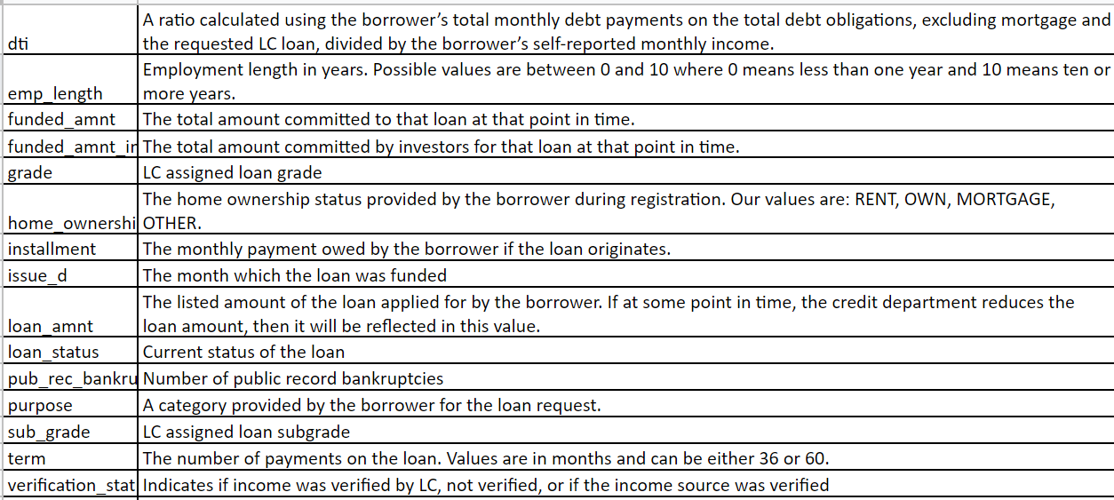
Data Snapshot

Slide 5
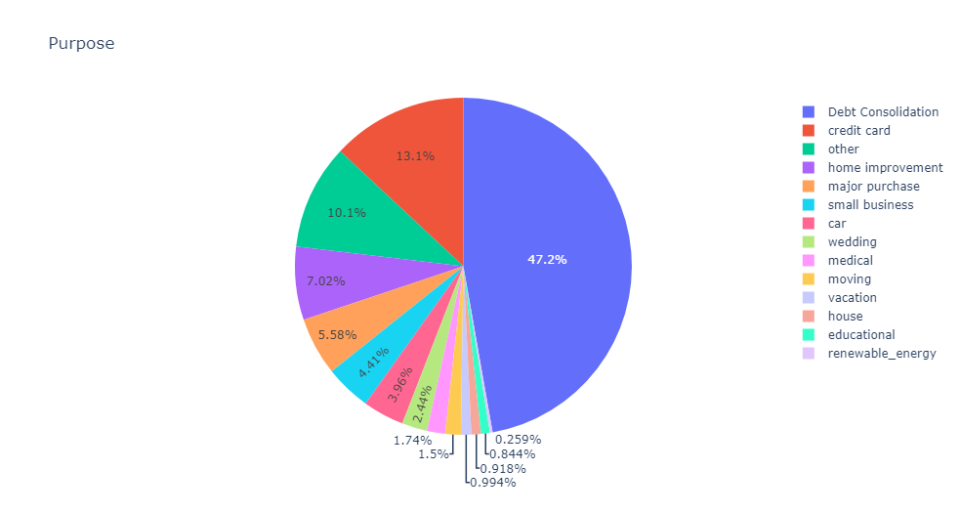
Top reasons for applying for a loan

Slide 6
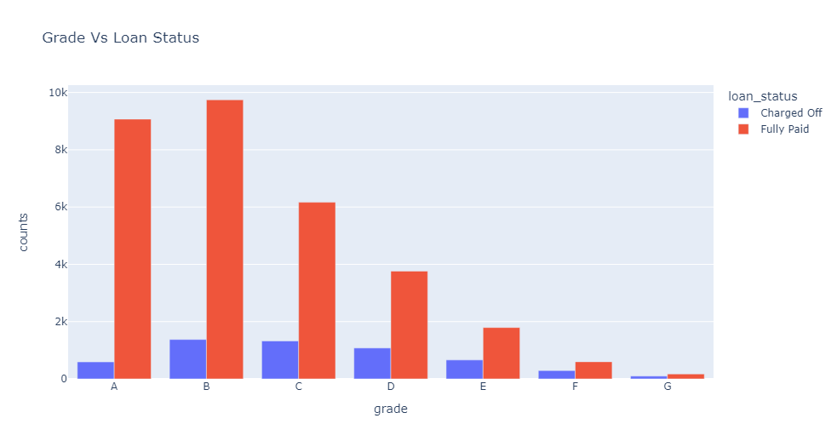
Risk Probability of loans

Slide 7
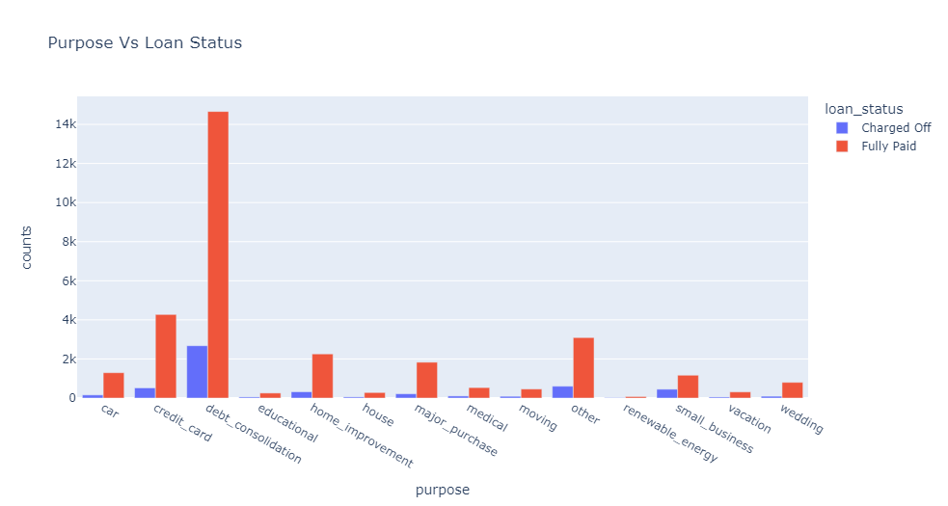
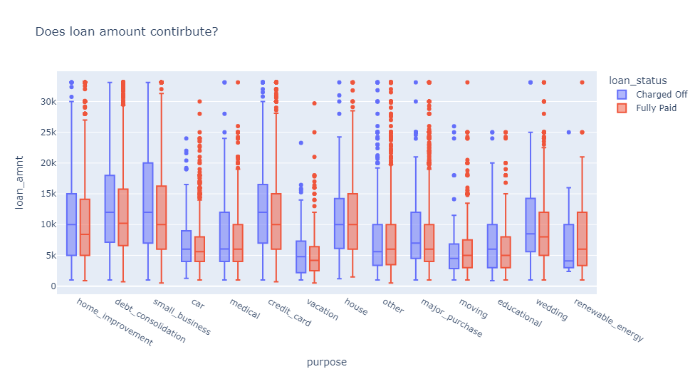
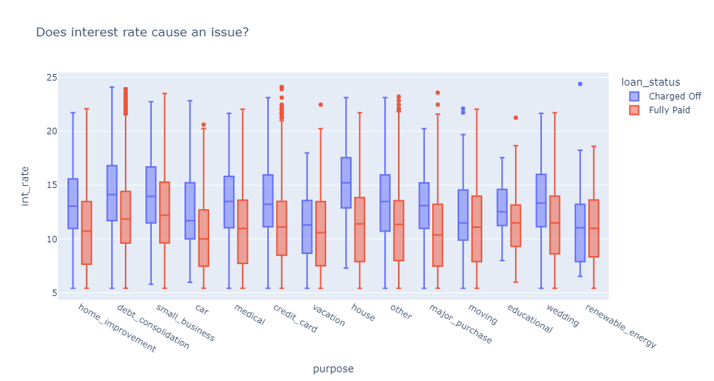
Who are the defaulters based on the reasons of application and why?
People borrowing loan for debt consolidation have highest risk of not repaying their loan on time. Lets a find a reason for this. From the above box plots we can observe that applicants of loan for "debt consolidation" have higher interest rate on loans than applicants that apply for other reasons which may be affecting their ability to repay their loans back on time.

Slide 8
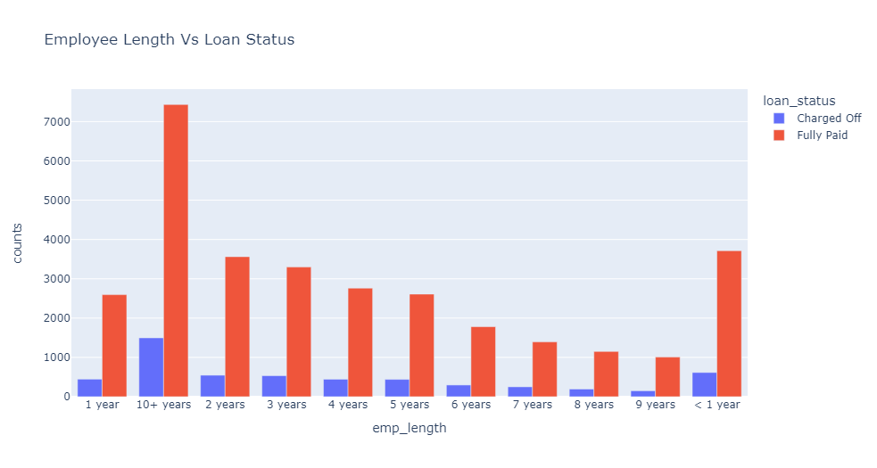
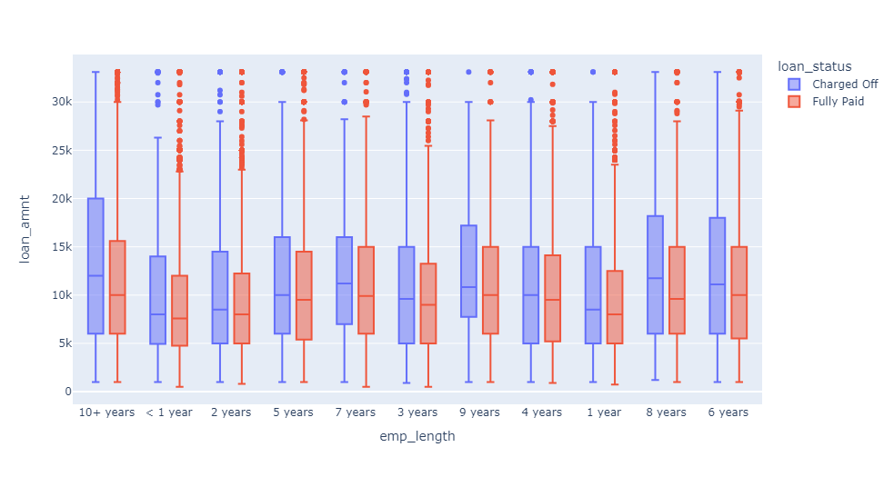
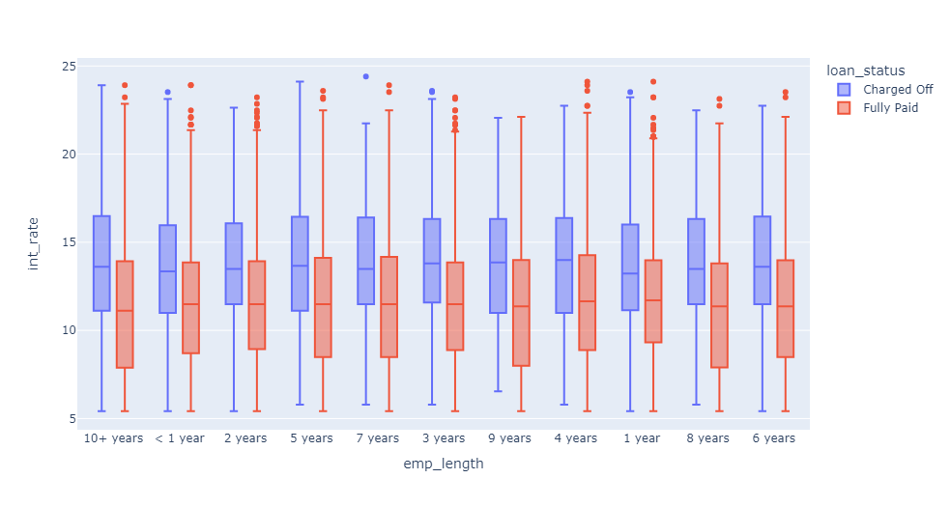
Defaulters based on employee length
After applicants with 10+ years of professional experience, people with <1 year experience have higher chance of defaulting. From above boxplots we can observe that applicants with less than one year of employee length have loans with high interest rates than others which is probably because their purpose for loan would largely be education which has 14.6% as its interest rate and applicants with <1 years employee length have 75% of interest rate around 15%

Slide 9
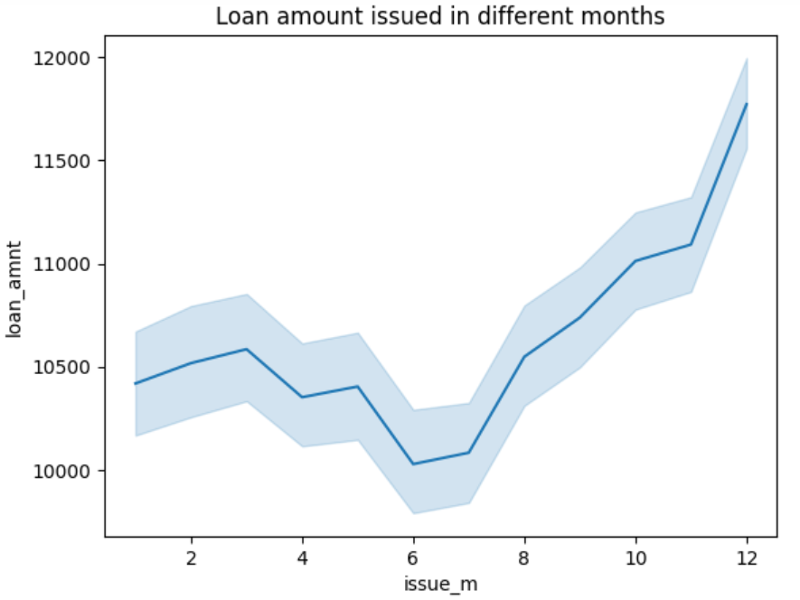
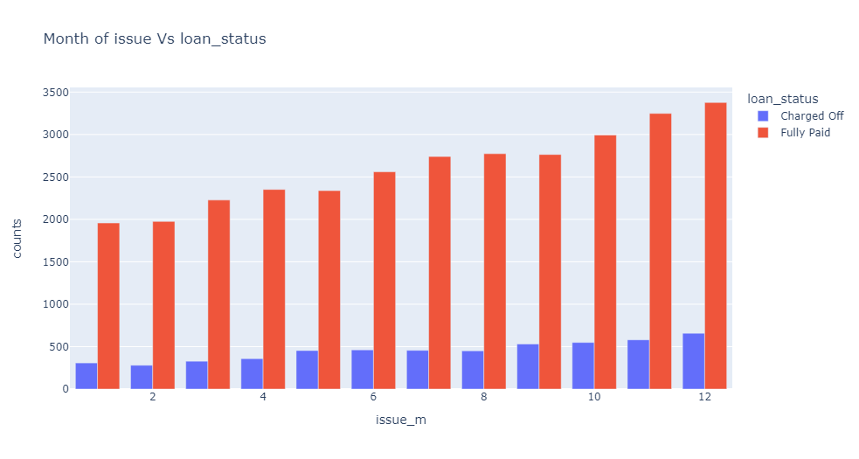
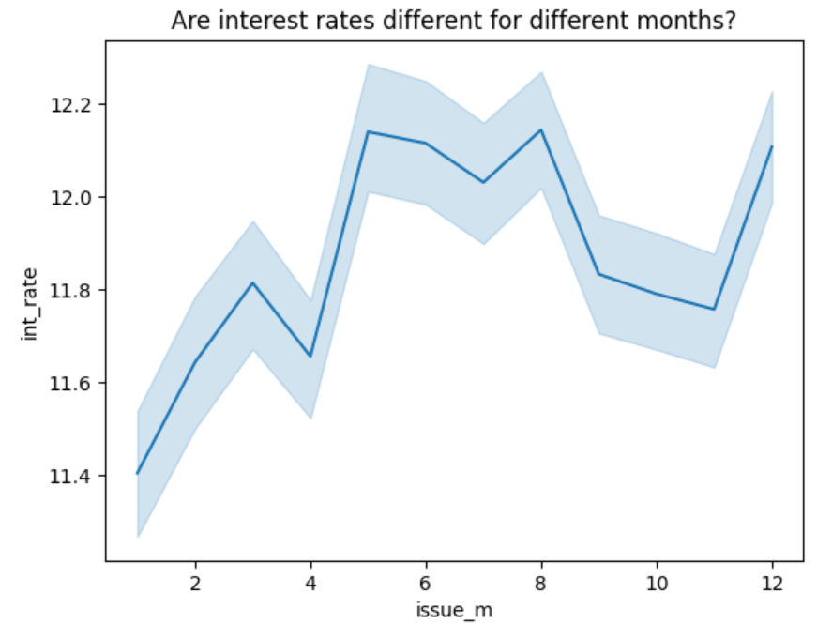
Does the month of issue affect the re-pyament of loan?
It looks like most loans are borrowed at the end of the year and with highest percentage of non-repayment. Also we observe a pattern that it keeps on increasing every month.
This may also be the reason because interest rates are high in the month of december and the loan amount applied are at peak in the month of december. Month of issue maybe a contributor to non-repayment. This observation may not help a banker to avoid the risk of lending loan to the wrong client but from the borrower perspective it will be better for someone to apply for the loan in months other than "May, August, December".

Slide 10
Conclusion
The dataset is either not equally distributed and is biased towards few values such as “debt consolidation, “10+ years experience” or most clients apply with the purpose of debt consolidation.
In that case, company should be careful to lending loans to these clients. One reason for defaulting may be higher interest rates on these personal loans.
There is a probability that loan granters are not grading the loans right as grade B loans have high chance of defaulting which contradicts the fact that grade B loans have lower risk of non-repayment.
From the perspective of loan borrower, one should apply in the months of lower interest rates and loans should be carefully lended in the months with high interest rates.
Verification status and home ownership don’t contribute much to defaulting but company should verify the income of the clients to be on the safer side.

